Slide 1




PROFILE
DISCOVERY PLANET COMANY LIMITED

Slide 2



WE ARE RECOGNIZED AS A YOUNG, QUALIFIED AND PROFESSIONAL TEAM, GREAT FINANCIAL STRENGTH, A PROVEN TRACK RECORD, AND THE RIGHT STRATEGIC PARTNER TO ENSURE AND MAINTAIN A LONG-TERM PARTNERSHIP WITH AIRLINES.
AIR SOLUTION

Slide 3


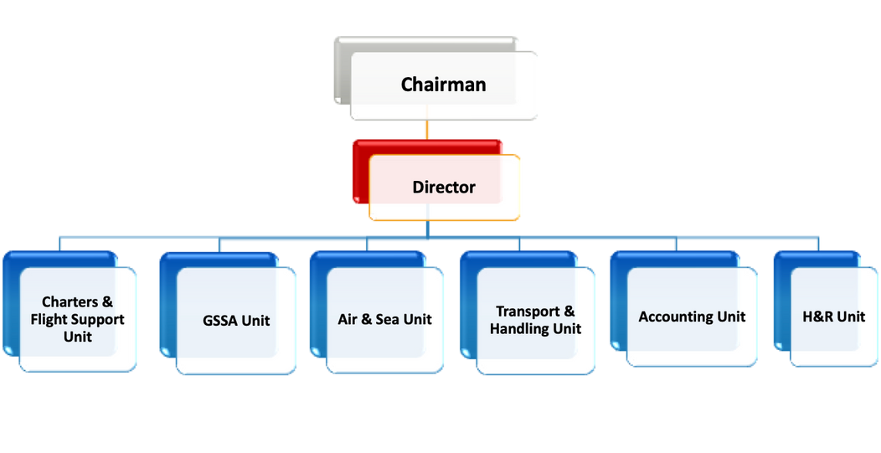
Well structured business
VALUE ADDED - FLEXIBILITY - RELIABILITY

Slide 4


About Us
Led by an experience management team with over 20 years experience with International Airlines General Sales Agency
Customer-driven with strong local relationships in the Vietnam market
VALUE ADDED - FLEXIBILITY - RELIABILITY

Slide 5






SERVICES WE PROVIDE
Cargo sales & logistics solutions
Cargo & Airport Operations
Aviation-related Support
•Airfreight & Multimodal transport solutions
•Charter services
•Interline cargo
•Feeder services
•B2B and B2C channel development
•Cargo handling & Flighting supervision
•Capacity & network management
•Safety & Security compliance
•SOP establishment & monitoring
•Airlines representatives for both schedule & charter flights
•Landing permits & slots
•Market research & Strategy consultancy
VALUE ADDED - FLEXIBILITY - RELIABILITY

Slide 6




Our Team
MANAGEMENT LEVEL
SENIOR EXECUTIVE LEVEL
•Wide connections with customers and local authorities
•Entrepreneur innovative mindset
•Over 20 years experience in Airline/ Air cargo industry
•Wide connection with international working experience
•Qualified IATA certificates for Introductory Courses, DG, Security training, and Customer Services
•Multi-lingual foreign language level: English, Mandarin, French and Bahasa Indonesia
Great Teamwork
Professional
Problem Solver

Slide 7

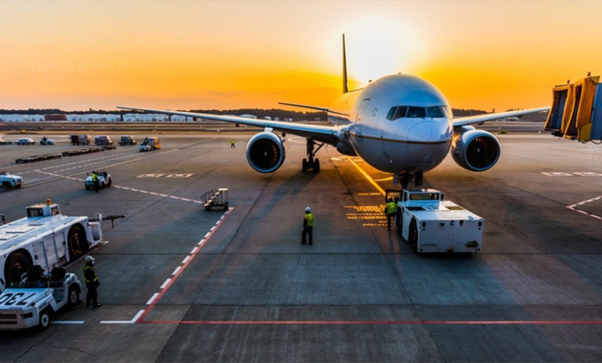
Our Abilities
CARGO SALE
  Targeted sales strategy with a comprehensive marketing plan
  Efficient Customer Support services
  Regular Market analysis
CARGO HANDLING
  Assistance in negotiation of SPA and partnerships with various strategic Carriers
  Road feeder service handling and coordination
  Prompt and accurate payment

Slide 8
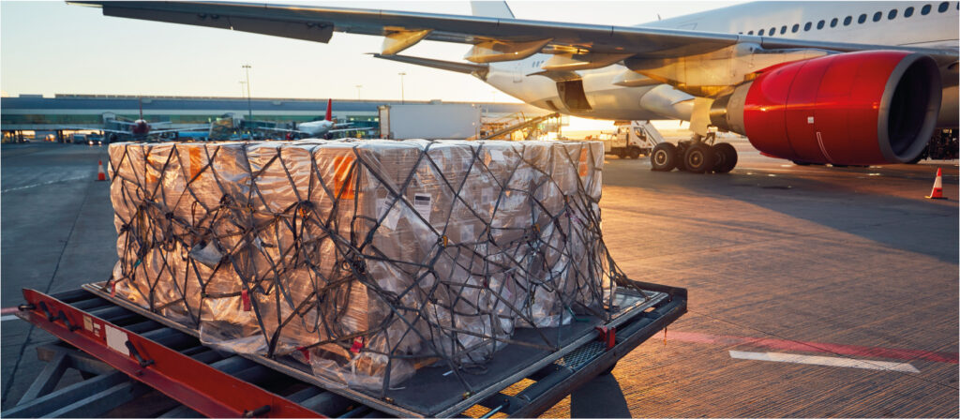
Our key to success
Sales
24/7 Operation
Administration
•E-freight management
•Customized e-business solutions
•Data monitoring: daily market analysis
•Marketing sales: cargo sustainability, airline branding
•Development & monitoring of SOP’s and other cargo communications protocols
•Capacity Management
•Customs facilitation
•Interline operations
•Tracking & tracing
•Cross Border Trucking solutions & connections out
•Billing, Administration, Collection for airfreight Transport, Direct invoices
•Management of all related costs (handling, trucking…)
•Complete transparency on billing details
•Punctual & Accurate payments
•Monthly report and revenue guarantee

Slide 9









Our Partners

Slide 10


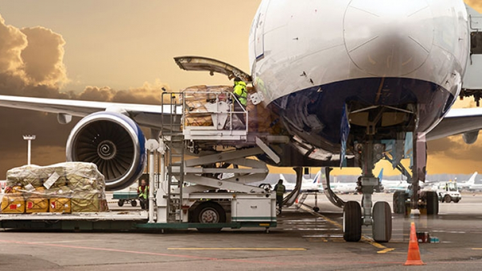
KEY MILESTONES
Being a key player on the ground allows us to bring our partner the right strategic approach
Air freight volume: more than 5,000 tones in 2022
More than 100 Freight Forwarder customers locally and internationally
Charter: 52 charters with many types of aircraft B737F/ B777F/ 747F/ B787Pax/ AN12
VALUE ADDED - FLEXIBILITY - RELIABILITY

Slide 11







Get in Touch
+84 (024) 3203 8628
+sales1@dcpvn.com
Floor 33, Discovery complex, 302 Cau Giay, Hanoi, Vietnam
In Discovery Planet, we believe long-term partnership is a key success for a strong and healthy business

